Slide 1
Excellus 2024 Pre OE meeting
OCTOBER 2023

Slide 2
agenda
Small Group Product Updates
Underwriting Updates
Questions

Slide 3
small group product updates

Slide 4
MEDICAL
2024 product updates
Outpatient Mental Health for Kids and Adults at Covered in Full​
Outpatient Mental and Behavioral Health services will be Covered in Full, subject to deductible, where applicable​
Improves upon health care outcomes and eliminates perceived barriers to care​
Applies to Non-Standard plans​
Effective 1/1/2024 upon renewal

Slide 5
MEDICAL
2024 product updates
Acupuncture at PCP Copay
Acupuncture will change to a PCP cost share on plans that previously applied a Specialist cost share
This will help make it more accessible and affordable
Provides less invasive care treatment options while supporting research from Clinical Pathways for alternatives modes of care
Applies to all Non-Standard plans
Effective 1/1/2024 upon renewal

Slide 6
MEDICAL
2024 product updates
Out-of-Network Out-of-Area Provider Reimbursement
We will be changing the amount we will reimburse Non-Participating providers, that reside outside our service area
We currently reimburse 150% of the Medicare fee schedule and will be changing to 100%
There is no impact to facility reimbursement (this is for allowable services only)
Applies to Standard and Non-Standard plans
Effective 1/1/2024, upon renewal

Slide 7
DEDUCTIBLE AND OUT-OF-POCKET MAXIMUM UPDATES
2024 product updates
Effective 1/1/2024, for new and existing groups, upon renewal, impacted plans shall be updated to comply with all regulatory amounts
Deductible
For HSA-qualified plans, In-Network deductibles must not be lower than the IRS HSA minimum of $1,600 for any one individual, or $3,200 for a family, as set forth by the IRS
Out-Of-Pocket Maximum
For HSA-qualified plans, In-Network Out-of-Pocket maximums must not be greater than the IRS HSA Maximum of $8,050 for any one individual, or $16,100 for a family, as set forth by the IRS
For Non-HSA qualified plans, In-Network Out-of-Pocket maximums must not be greater than the ACA Maximum of $9,450 for any one individual, or $18,900 for a family, as set forth by HHS

Slide 8
Metal compliance updates

Slide 9
METAL COMPLIANCE
Metal compliance updates
Each year all carriers in NYS must test their plans for metal level compliance. At Excellus, we use the federal calculator developed by Centers for Medicare & Medicaid Services (CMS).
The calculator tests the cost shares of the packages for compliance with the market stabilization ranges shown below
Plans that fail metal level testing have been adjusted for compliance
Metal Level & Actuarial Value | Market Stabilization Changes
Platinum 90% | -2%/+2% (88% - 92%)
Gold 80% | -2%/+2% (78% - 82%)
Silver 70% | -0%/+2% (70% - 72%)
Bronze 60% | -2%/+2% (58% - 62%)
Expanded Bronze* 60% | -2%/+5% (58% - 65%)
* Must be HSA compliant or have a major service covered before the deductible
For 2024, there were changes incorporated in the AV Calculator

Slide 10
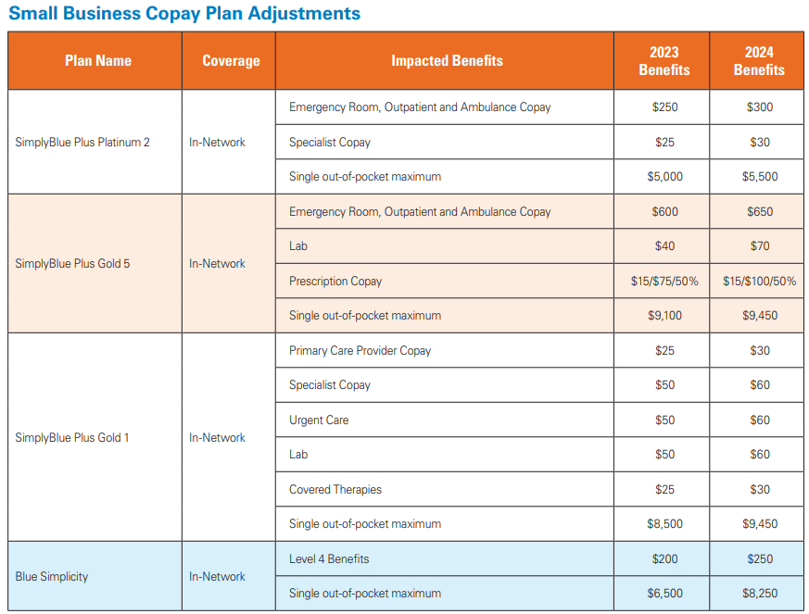
2024 Small group copay plan adjustments
Metal compliance updates
Additional Items
All Enrollment Codes will change in 2024
Cost-share changes are effective upon 2024 renewal date
Charts are also included in the Product Guide and on Blue on Demand
There are no uniform modifications (discontinuances or retirements) for 2024

Slide 11
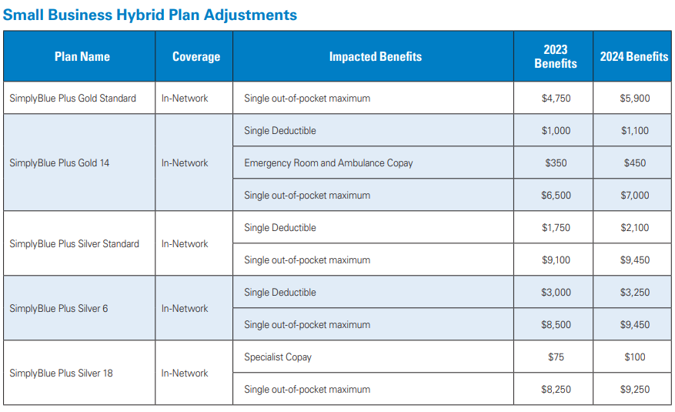
2024 Small group hybrid plan adjustments
Metal compliance updates
Additional Items
All Enrollment Codes will change in 2024
Cost-share changes are effective upon 2024 renewal date
Charts are also included in the Product Guide and on Blue on Demand
There are no uniform modifications (discontinuances or retirements) for 2024

Slide 12
2024 Small group HSA plan adjustments
Metal compliance updates
Additional Items
All Enrollment Codes will change in 2024
Cost-share changes are effective upon 2024 renewal date
Charts are also included in the Product Guide and on Blue on Demand
There are no uniform modifications (discontinuances or retirements) for 2024

Slide 13
NEW!
ThriveWell

Slide 14
New! ThriveWell
WELLBEING FOR ALL, ALL IN ONE PLACE
ThriveWell powered by Virgin Pulse
Beginning 1/1/24, we are launching a new digital health and wellbeing program through a partnership with Virgin Pulse
Designed to bring wellbeing resources together into a seamless, personalized, and easy-to-use experience
Available as a desktop, tablet or mobile experience
Intrinsically motivates and supports overall holistic wellbeing such as physical, emotional, social and financial wellbeing
Embedded for all community rated small groups, upon renewal

Slide 15
SMALL GROUP REWARD DESIGN
WELLBEING FOR ALL, ALL IN ONE PLACE
Max Reward: Up to $400 Annually ($200 subscriber / $200 spouse or domestic partner)
Hybrid Reward Design: $25 earned in Action Reward (Complete HRA); $175 earned in Points & Levels Games
Pulse Cash (PC): Virgin Pulse’s on-platform rewards currency
Initiative/Action Reward: Health Check
Action | Requirement(s) | Completion Deadline | Reward Type & Value
Health Check | Complete the Health Check (online or mobile) |  | $25 Pulse Cash (PC)
Points & Levels | Level 1 | Level 2 | Level 3 | Level 4
 | 7,000 points | 25,000 points | 40,000 points | 60,000 points
Reward Value | $15 PC | $35 PC | $55 PC | $70 PC

Slide 16
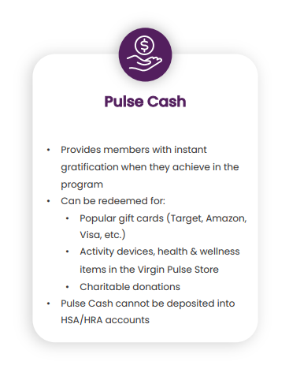
REWARD REDEMPTION
WELLBEING FOR ALL, ALL IN ONE PLACE
Pulse Cash
Members earn Pulse Cash for their participation within the platform​
Pulse Cash is Virgin Pulse’s on-platform currency that can be redeemed for:​
Gift cards (Target, Amazon, Visa, etc.) ​
Gift cards are primarily digital, but members have the option to choose to redeem a physical Visa gift card
Activity devices, health and wellness items in the Virgin Pulse Store​
Charitable donations

Slide 17
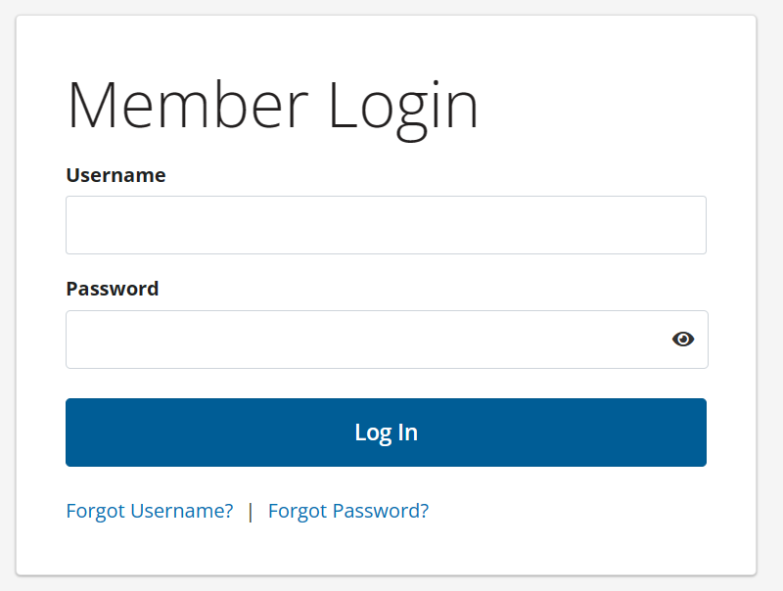
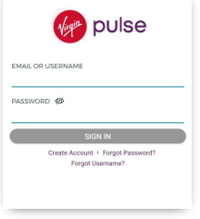
MEMBER ACCESSIBILITY
WELLBEING FOR ALL, ALL IN ONE PLACE
Members can access Virgin Pulse one of two ways:
Go to Excellus Member Portal and click on ThriveWell to be transported to Virgin Pulse platform.
Go directly to Virgin Pulse and search for organization on the Sign Up page.
Once the member lands on Virgin Pulse’s enrollment page, member will need to complete three steps to create an account:
1. Identify: Virgin Pulse will ask for a few personal details to confirm that eligibility to create an account.
2. Agree: Member will read and agree to Virgin Pulse’s legal terms and privacy practices.
3. Create: Check email inbox to find the link from Virgin Pulse. The link in the email will redirect to the enrollment page to create a password and proceed.

Slide 18
Wellbeing Transitions
WELLBEING FOR ALL, ALL IN ONE PLACE
2023 Program | 2024 Program
Active&Fit ExerciseRewards | NEW! ThriveWell with Rewards
Active&Fit Direct | Access until 2024 renewal and beyond
Calm Stress Management | NEW! ThriveWell without Rewards
Blue 365 Discounts | Blue 365 Discounts
Blue365 Fitness Your Way | Blue365 Fitness Your Way

Slide 19
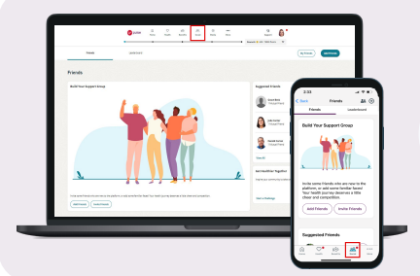
Transition Timeline
Wellbeing for all, all in one place
Group Specifics | Program access | Date
Non-Calendar (2/1-12/1) renewal business | Access to Calm ends | 12/31/2023
Non-Calendar (2/1-12/1) renewal business | Access to ThriveWell without Rewards begins as the Calm replacement | 1/1/2024 -> renewal
Non-Calendar (2/1-12/1) renewal business | Access to ThriveWell with Rewards begins | Upon renewal
Calendar (1/1) renewal business | Access to ThriveWell with Rewards begins | 1/1/2024
How will ThriveWell replace Calm as a Stress Management Program?
Daily tips to promote healthy habits
Personalized healthy behavior challenges
Digital coaching
Peer to peer challenges focused on mental wellbeing
Mindful eating suggestions
Workout videos with exercise tracking for mental health benefits
Mood tracking, self help videos
Sleep tracking, ability to sync to a wearable device
Guided meditations

Slide 20
Dental updates

Slide 21
DENTAL
2024 product updates
Dental Blue Options LITE Package Retirement
Lite package options will be discontinued (Pediatric Dental coverage for age 19 to 26 only plans) in the Dental Blue Options portfolio
Groups and members will automatically be mapped into the default Dental Blue Options package provided
Effective 1/1/2024 for Small Group plans

Slide 22
Dental updates
Starting with April 1, 2024 renewals, we will begin moving groups to the correct group size and non-renewing single contract groups with only dental.
We will communicate about dental groups with 1 contract prior to issuing non-renewal notices and provide resources to help them transition to a plan through the individual market.
Quick reminder on contribution that groups should be in the correct contributory or voluntary product based on the amount of employer contribution toward the dental premium.
One guideline update: Groups with single contract Dental and Medical coverage with The Health Plan will qualify for dental coverage.

Slide 23
Underwriting updates

Slide 24
Form Updates
New Business Application
Dental eligible employees question added.
Updated formatting to look similar to AGIF.
Minor verbiage updates.
Annual Group Information Form (AGIF) and Webtool
Dental eligible employees question added.
When new form is released, Webtool will also be updated.
Healthy NY Recertification Form
Currently in development.
Will include standard recertification questions and some questions from the AGIF.
This will eliminate the need to collect multiple forms from Healthy NY groups.
New versions of the New Business and AGIF forms will be rolled out in Q4 2023. We will require new forms for New Business and renewals effective 4/1/2024. The updated HNY recert form has no current ETA, and further information will be sent once available.

